Slide 1

Introduction to MSLA &
First Steps With C#
(Using Visual Studio Code)
Mansi Bisht
Alpha Microsoft Learn SA

Slide 2
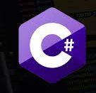
Objectives:
Introduction to Microsoft Learn Ambassador Program
Installation and Set-Up of VSCode
Beginner level understanding with creating literal values and declare variables of basic data types like string, int, and decimal.
Perform mathematical operations on numeric values
Observe implicit type conversion between strings and numeric values
Temporarily convert one data type into another

Slide 3
About Microsoft Learn Student Ambassadors:
Find your community is more important than ever as classes and social activities take place virtually.
Amplify your impact and bring together your peers to learn new skills, solve real-world problems, and build communities across the globe.
Attend workshops and events, chance to upskill.

Slide 4

How to apply?
https://studentambassadors.microsoft.com/en-US/

Slide 5

Roadmap

Slide 6
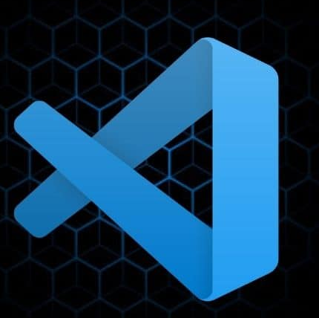
Visual Studio Code
Visual Studio Code is an integrated development environment made by Microsoft for Windows, Linux and macOS.
Features include support for debugging, syntax highlighting, intelligent code completion, snippets, code refactoring, and embedded Git.
Developer: Microsoft
Initial release: April 29, 2015; 6 years ago

Slide 7
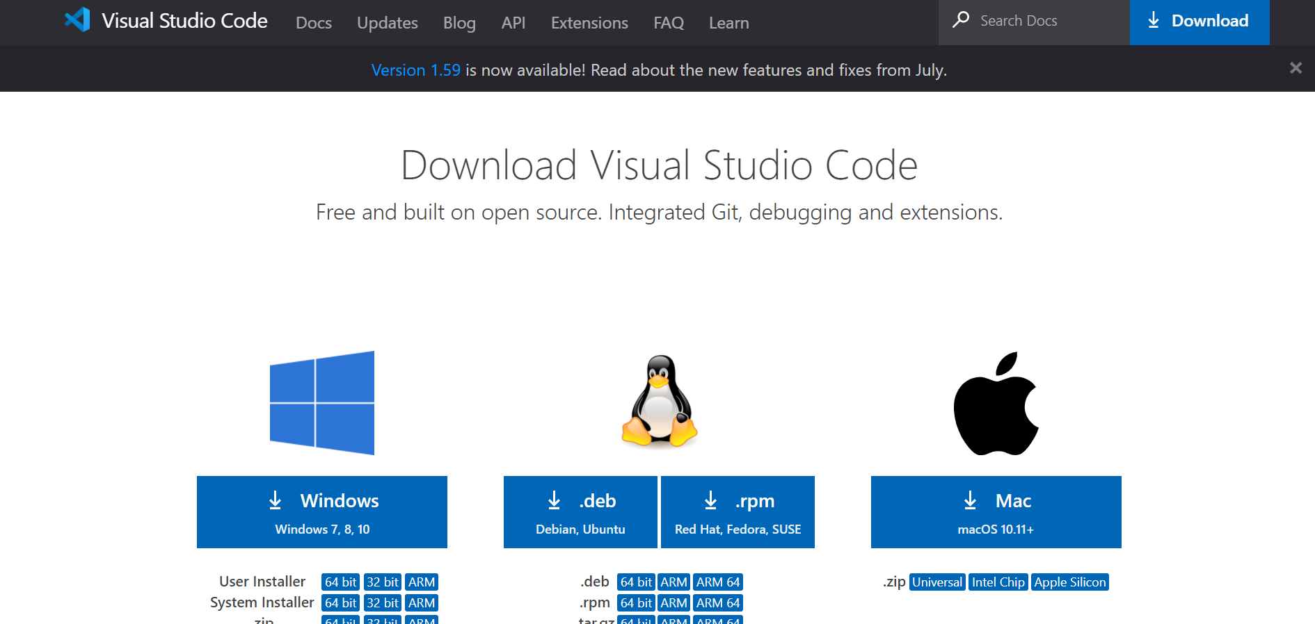
Installation Guide:

Slide 8
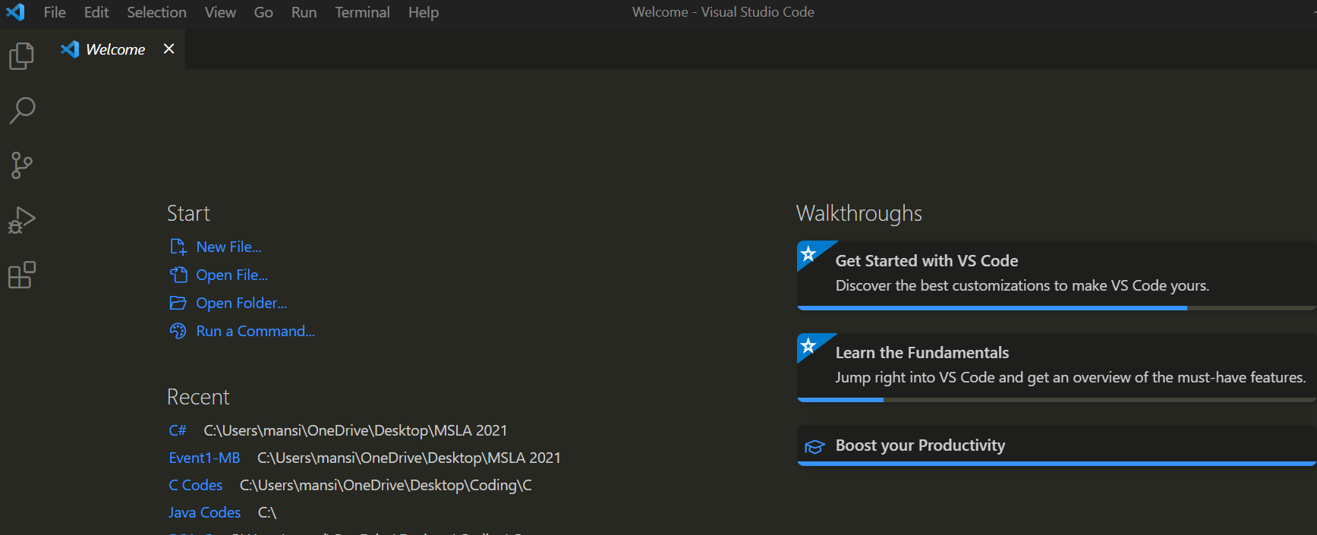
Understanding VSCode’s Interface:

Slide 9
Set-Up and Installation
Prerequisites:
Install the following:
.NET Core SDK. The SDK also includes the Runtime.
The C# extension from the VS Code Marketplace.
The F# extension (Ionide) from the VS Code Marketplace.

Slide 10
Resources
Visual Studio Code: https://code.visualstudio.com/
.NET Core SDK: https://dotnet.microsoft.com/download
The C# extension: https://marketplace.visualstudio.com/items?itemName=ms-dotnettools.csharp
The F# extension: https://marketplace.visualstudio.com/items?itemName=Ionide.Ionide-fsharp

Slide 11
Create a C# File
Initialize a C# project.
Open a terminal/command prompt and navigate to the folder in which you'd like to create the app.
Enter the following command in the command shell:
dotnet new console
When the project folder is first opened in VS Code:
A "Required assets to build and debug are missing. Add them?" notification appears at the bottom right of the window.
Select Yes.
Run the app by entering the following command in the command shell:
dotnet run

Slide 12
What is C# ?
C# is pronounced as C-Sharp.
C# was launched by Microsoft Corporation in 2000.
C# (C-Sharp) is a programming language developed by Microsoft that runs on the .NET Framework.
C# is used to develop web apps, desktop apps, mobile apps, games and much more.

Slide 13

Boilerplate code:
Namespaces in C# are used to organize too many classes so that it can be easy to handle the application. In a simple C# program, we use System. Console where System is the namespace and Console is the class. To access the class of a namespace, we need to use <namespacename>.
Static: It means Main Method can be called without an object.
Public: It is access modifiers which means the compiler can execute this from anywhere.
Void: The Main method doesn't return anything. If there is a need for command-line arguments then the user must specify the command line arguments in the Main method.

Slide 14
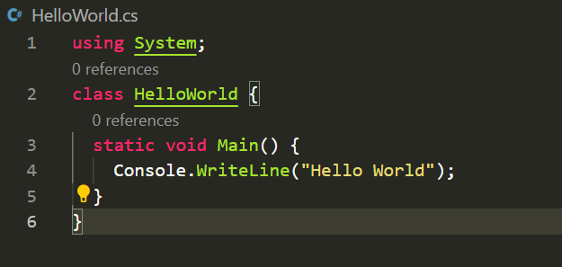
First C# Program!
Syntax to print output.
Double quotes because we’re printing string.
Semicolon indicates the termination of a line of code.
Note: C# is a case-sensitive language, meaning that the C# compiler considers the words console and Console as different as the words cat and dog

Slide 15
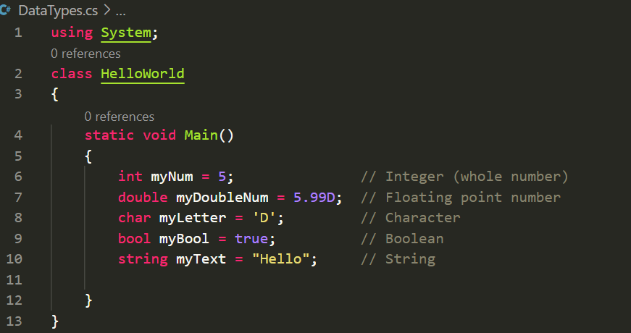
Datatypes in C#

Slide 16
Variables in C#
A variable is a data item that may change its value during its lifetime.
Variable names can contain alphanumeric characters and the underscore character. (# and $ are not allowed)
Variable names must begin with an alphabetical letter or an underscore, not a number.
Variable names must not be a C# keyword.
Variable names are case-sensitive.

Slide 17
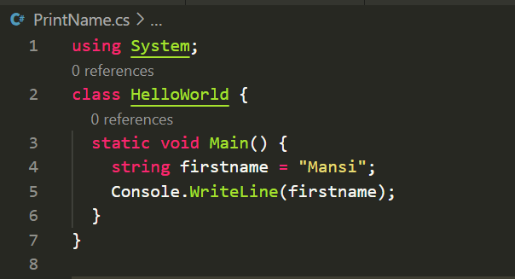
Retrieve and Print

Slide 18
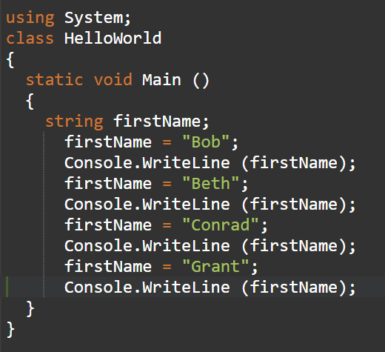
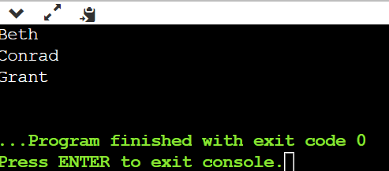
Reassign the value of a variable.

Slide 19
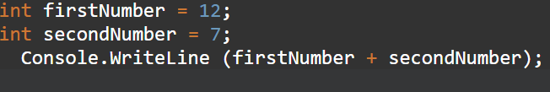
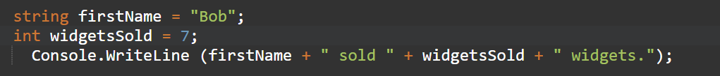
Simple Addition and Implicit Data Conversion
Step 1: Add two numeric values
Step 2: Mix data types to force implicit type conversions

Slide 20
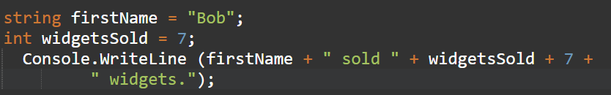
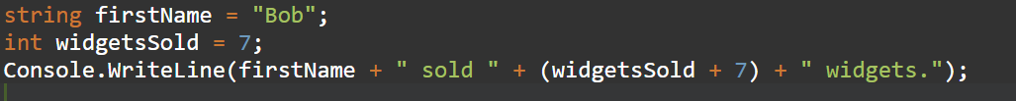
Simple Addition and Implicit Data Conversion
Step 3: Attempt a more advanced case of adding numbers and concatenating strings
Step 4: Add parentheses to make our intention clear to the compiler

Slide 21
Math Operators
+ is the addition operator
- is the subtraction operator
* is the multiplication operator
/ is the division operator

Slide 22
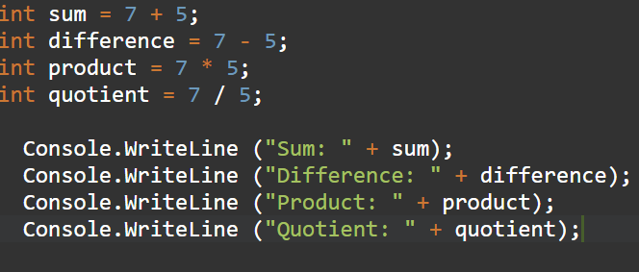
Perform Basic Math Operations

Slide 23

Facts about C#!
C# is case-sensitive.
The extension of C# files is .cs
The name of the C Sharp language is stimulated by the musical notation. Here sharp, represent the written note which should be made a semitone higher in pitch.
The syntax of C# language is similar to the C-style family such as Java, C, C++.

Slide 24
Connect with me
GitHub: https://github.com/mansibisht22
LinkedIn: https://www.linkedin.com/in/mansi-bisht-/
E-Mail: mansibisht229@gmail.com

